Slide 1
eXtreme Gradient Boosting-XG BOOST
What is XGBoost?
XGBoost stands for eXtreme Gradient Boosting. It’s a parallelized and carefully optimized version of the gradient boosting algorithm. Parallelizing the whole boosting process improves the training time significantly.
Instead of training the best possible model on the data (like in traditional methods), we train thousands of models on various subsets of the training dataset and then vote for the best-performing model.
In many cases, XGBoost is better than usual gradient-boosting algorithms. The Python implementation gives access to a vast number of inner parameters to tweak for better precision and accuracy.

Slide 2
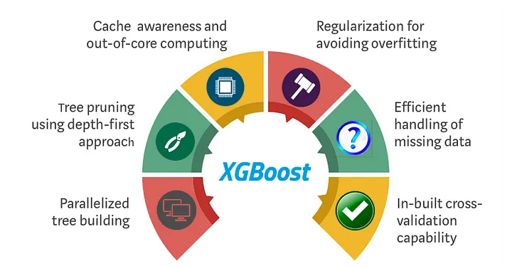

Slide 3
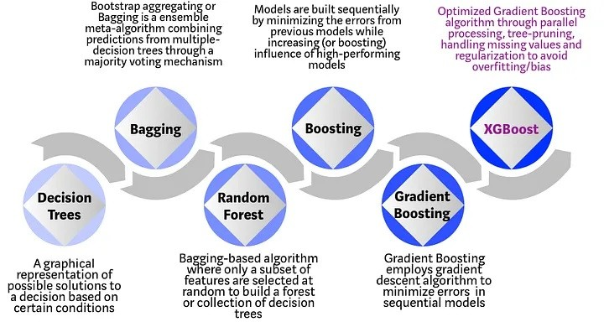

Slide 4
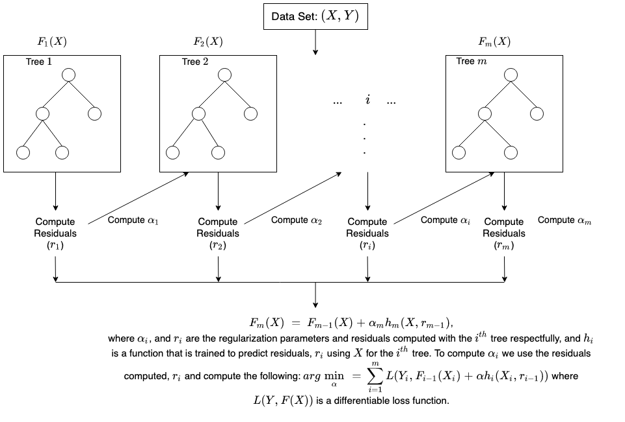
How does XGBoost work?

Slide 5
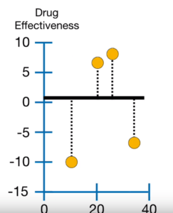


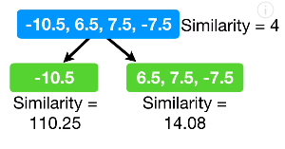
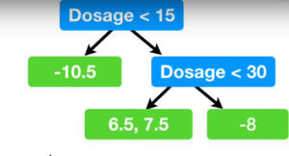

Example:
Here λ is a regularisation parameter.

Slide 6
